Slide 1
Hydropower Plant

Slide 2
Working Principle
Hydropower plants capture the energy of falling water to generate electricity. A turbine converts the kinetic energy of falling water into mechanical energy. Then a generator converts the mechanical energy from the turbine into electrical energy.

Slide 3
Types OF HYDROELECTRIC POWER PLANTS
Hydropower facilities range in size from large power plants, which supply many consumers with electricity, to small and even ‘micro’ plants, which are operated by individuals for their own energy needs or to sell power to utilities.
Large Hydropower
large hydropower plants have a capacity of more than 30 megawatts (MW).
Small Hydropower
small hydropower plants generate between 100 kilowatts and 10 MW.
Micro Hydropower
A micro hydropower plant has a capacity of up to 100 kilowatts. A small or micro hydroelectric power system can produce enough electricity for a single home, farm, ranch, or village.

Slide 4
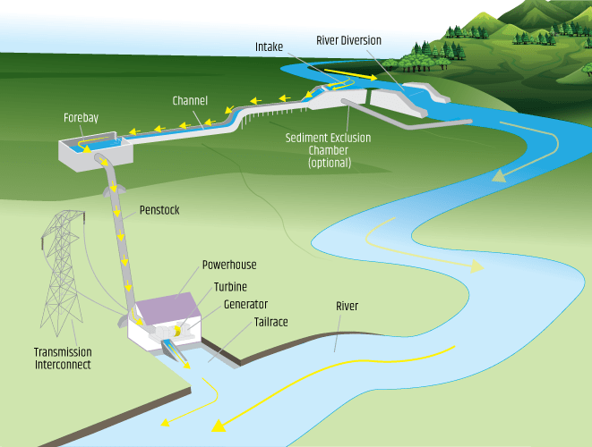
Construction
The major components of a Hydroelectric Power Plant are:-
Dam/Barrage
Desilting chambers.
tunnels/channels
Penstock
Turbine

Slide 5
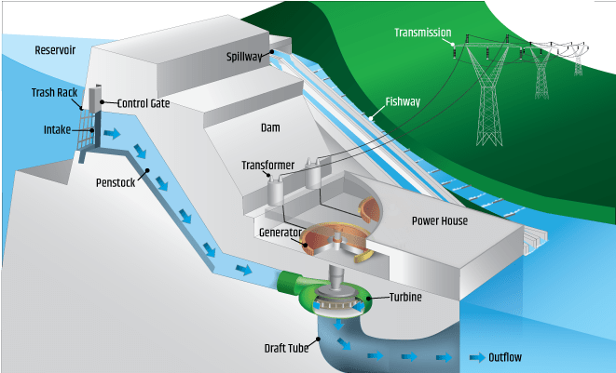
Working
hydropower system, uses a dam to store river water in a reservoir. Water released from the reservoir flows through a pipe known as a penstock. The water spins the blades in a turbine, spinning it, which in turn activates a generator to produce electricity. The water may be released to meet changing electricity needs or other needs, such as flood control, recreation, fish passage, and other environmental and water quality needs

Slide 6
Environmental Impacts of hydropower Plants
Loss of Land :
Flooding land for a hydroelectric reservoir has an extreme environmental impact: it destroys forest, wildlife habitat, agricultural land, and scenic lands.
Impact on aquatic ecosystems:
Fish and other organisms can be injured and killed by turbine blades.
The reservoir have high amounts of sediments and nutrients, which can cultivate an excess of algae and other aquatic weeds. These can crowd out other river animal and plant-life.
Global warming emissions:
Global warming emissions during a facility’s operation can be significant..
Small run-of-the-river plants emit between 0.01 and 0.03 pounds of carbon dioxide equivalent per kilowatt-hour While hydroelectric plants emit approximately 0.06 pounds of carbon dioxide equivalent per kilowatt
Migrations:
People in the targeted area are Relocated.

Slide 7
Applications
Dammed reservoirs are used for multiple purposes, such as agricultural irrigation, flood control, and recreation

